Slide 1
Vehicle Rental Statewide Contracts
Statewide Contract Webinar – February 19, 2015
SPD-CP031
Revised 02/10/11
Georgia State Purchasing Division
http://statepurchasing.doas.georgia.gov

Slide 2
Your Presenter State Purchasing Division – Contracting Officer
Willie Moon
Associate Category Manager
Experience
Background - 20 years in Procurement
Joined DOAS in June 2007
Certifications
Certified Professional Public Buyer (CPPB)
Georgia Certified Purchasing Associate (GCPA)
Contract Information
Willie.moon@doas.ga.gov
404-656-0931

Slide 3
Purpose of this Webinar State Purchasing Division – Statewide Contracts
1.EXPLAIN
the purpose
2. PROVIDE contract details
3. RESERVATION PROCESS
4. ONE WAY RENTAL
5. REVIEW contract rates
6. FIND the contract on the website
7. CUSTOMER FEEDBACK

Slide 4
Purpose of this Webinar State Purchasing Division – Statewide Contracts
Purpose:
The purpose is to provide an overview of the Vehicle Rental Program.

Slide 5
Statewide Contract Details State Purchasing Division – Statewide Contracts
What are the Contract Numbers?
Contract # 99999-SPD-40199376(CR-01), (IS-01,02), (BS-01)
Is it a Renewal?
No
Does it Replace an Existing Contract?
Yes
What is the Contract Term?
5 Years
What are the Expiration Dates?
2015
Does it Allow the Use of the P-Card?
Yes
Who is the Person to Contact with Questions:
Debra White
Debra.White@doas.ga.gov
404-463-0232
Notes:
Three renewals

Slide 6
Vehicle Rental Services Providers
Capitol Hill – The Hertz Corporation
Inter-State (Airport) – The Hertz Corporation
In – State (Georgia locations other than Airport) The Hertz Corporation and Enterprise Car Rental
15 Passenger Bus and Other Bus Types – AutoMax Rent-a-Car dba BusMax
Notes:
Hertz is proud to be your low cost provider on Airport, Capitol Hill, and throughout Georgia!!

Slide 7
Enterprise & State of Georgia
Over 200+ Georgia Locations to service you
Free Pick-up service
LDW/Liability included in rates
Direct billing available
Personal Travel Program
Spring Street location – 116 Spring Street SW
Optional Box Truck rentals
Free one way rental

Slide 8
Hertz - State of GA Rental Program
Free Pick-up and Delivery/Staging available
All state renters greater than 30 miles from nearest Hertz can have a vehicle delivered or staged at facility for free.
LDW/Loss Damage Waiver included in rates
Direct billing available in-state and out of state renters
Free one way rental instate
Personal Travel Program
Hertz Gold Rewards
Speed and Expedited Airport Service
Airport renters get Mobile Alerts sent to your phone to let you know which car you will be driving and where it is parked the minute it is ready.
Notes:
Contact Brian Burtzlaz for enrollment

Slide 9
Reservation Process

Slide 10
Vehicle Cost Calculator
Vehicle Cost Calculator (if required by your Agency)
Renters should begin their reservation process by completing the steps in the Vehicle Cost Calculator
If rental car is recommended as the most economical mode of transportation, proceed to booking the reservation by clicking on the link at the bottom of the page
Notes:
Hertz is proud to be your low cost provider on Airport, Capitol Hill, and throughout Georgia!!

Slide 11
BOOKING A RENTAL
Renters Agency must be enrolled in Direct Billing for Agency billing
Enterprise: Use portal for In-State rentals, call rental location, 1-800-Rent-a-Car, walk-in
Hertz: Use portal for In-State, Capitol Hill and Inter-State (Airport) rentals; call rental location or 1-888-444-8500, walk-in
Auto Max dba BusMax: www.busmaxrental.com Call closest rental facility: Cartersville – 770-607-7000, Norcross – 770-Bus-Rent, Rome 706-291-0600

Slide 12
ONE WAY RENTALS
One-Way Charges will not apply to rentals picked up and dropped off at a Enterprise or Hertz locations within the State of Georgia
A mileage fee of $0.25/mile will apply to Hertz Airport One Way Rentals
Notes:
Hertz is proud to be your low cost provider on Airport, Capitol Hill, and throughout Georgia!!

Slide 13
GAS CARDS
Enterprise – Downtown 116 Spring Street location
Hertz – Capitol Hill location
Renters will be issued a fuel card at the time of rental. Fuel card is for business travel to fuel the rental vehicle only.
A Personal ID Number will be provided to Renter for refueling
Gas card and receipt for fuel purchases will be returned with keys (includes one way rentals)
Fuel will be charged according to the following formula: Cost per Gallon of Fuel ÷ Avg. MPG by car class = Cost per Mile; Cost per Mile X # of Miles Driven = $$ Fuel Charged
Fuel charges will show up as Curbside Return on invoices
Unauthorized use of fuel card is stickily prohibited
Renters Agency will be notified of unauthorized use of the fuel card

Slide 14
Refueling your Rental
Each vehicle should be supplied with a full tank of gas at pick up
When refueling the vehicle renters should return it at the same level of fuel as when the vehicle was picked up
For example: If you picked up the vehicle with a half of tank of gas. The vehicle should be returned to the rental location at a half of tank of gas.
*When using the fuel card vehicles may be returned with a full tank of gas
Notes:
Hertz is proud to be your low cost provider on Airport, Capitol Hill, and throughout Georgia!!

Slide 15
Capitol Hill and Inter-State (Airport) Rental Rates
Hertz Capitol Hill Standard Rate
Vehicle Class | 1/2 Day (hourly) | Daily | Weekly | Monthly
Compact | $12.50 | $25.00 | $150.00 | $600.00
Intermediate | $13.00 | $26.00 | $156.00 | $624.00
Full Size | $14.00 | $28.00 | $168.00 | $672.00
12 Passenger Van | $29.50 | $59.00 | $354.00 | $1,416.00
Mini Vans | $24.50 | $49.00 | $294.00 | $1,176.00
Mid-Size SUV | $24.50 | $49.00 | $294.00 | $1,176.00
*Hertz Inter-State (Airport) Standard Rate
Vehicle Class | Daily | Weekly | Monthly
Compact | $32.00 | $192.00 | $768.00
Intermediate | $34.00 | $204.00 | $816.00
Full Size | $37.00 | $222.00 | $888.00
12 Passenger Van | $88.55 | $531.30 | $2,125.20
Mini Vans | $63.25 | $379.50 | $1,518.00
Mid-Size SUV | $59.80 | $358.80 | $1,435.20
*.025 per mile one way rental Airport

Slide 16
Inter-State (Airport) Rental Surcharges
Airport Rental Surcharges*
Frequent Airport Cities | Surcharge |  | Airport Cities |  | Surcharge |  | Airport Cities |  | Surcharge
ATLANTA INTL ARPT | $0.00 |  | John Wayne AP |  | $3.00 |  | Newark |  | $19.00
LOS ANGELES INTL ARPT | $0.00 |  | Oakland AP |  | $3.00 |  | JFK, LGA, Manhattan |  | $29.00
SAN FRANCISCO INTL | $0.00 |  | San Jose AP |  | $3.00 |  | Bend |  | $10.00
ORLANDO INTL ARPT | $0.00 |  | San Luis Obispo |  | $13.00 |  | Klamath Falls |  | $10.00
DCA REAGAN ARPT | $8.00 |  | Washington |  | $8.00 |  | Medford |  | $10.00
DENVER INTL ARPT | $0.00 |  | Idaho Falls |  | $6.00 |  | Pendleton |  | $10.00
BALT WASHINGTON INTL | $8.00 |  | Boise |  | $6.00 |  | Redmond |  | $10.00
SAN DIEGO INTL ARPT | $0.00 |  | Hailey |  | $10.00 |  | Salem Airport Only |  | $10.00
TAMPA INTL ARPT | $0.00 |  | Lewiston |  | $20.00 |  | Sun River |  | $10.00
BOSTON LOGAN INTL | $8.00 |  | Pocatello |  | $6.00 |  | Philadelphia |  | $8.00
LAS VEGAS INTL ARPT | $0.00 |  | Sun Valley |  | $6.00 |  | Pasco |  | $10.00
PHX SKY HARBOR INTL | $0.00 |  | Chicago |  | $8.00 |  | Pullman |  | $6.00
FLL INTL ARPT CRCF | $0.00 |  | Boston |  | $8.00 |  | Spokane |  | $6.00
HONOLULU INTL ARPT | $0.00 |  | Baltimore |  | $8.00 |  | Walla Walla |  | $10.00
AUSTIN BERGSTROM | $0.00 |  | Detroit |  | $8.00 |  | Wenatchee |  | $10.00
 |  |  | Missoula |  | $6.00 |  | Yakima |  | $10.00
 |  |  | Butte |  | $10.00 |  | Burbank AP |  | $3.00
*There is a .25/mile one way drop off fee for all airport rentals. Loss Damage Waiver (LDW), Collision Damage Waiver (CDW) and Vehicle Licensing Fees (VLF) are included in daily, weekly and monthly rates.
Notes:
No federal tax. State we do pay state taxes at Air ports in other state.

Slide 17
In-State Rental Rates
Hertz In-State Standard Rate
Vehicle Class | Daily | Weekly | Monthly
Compact | $28.00 | $168.00 | $672.00
Intermediate | $29.00 | $174.00 | $696.00
Full Size | $32.00 | $192.00 | $768.00
12 Pass Van (only) | $77.00 | $462.00 | $1,848.00
Mini Vans | $55.00 | $330.00 | $1,320.00
Mid-Size SUV | $52.00 | $312.00 | $1,248.00
Enterprise In-State Standard Rate
Vehicle Class | Daily | Weekly | Monthly
Compact | $30.15 | $165.83 | $663.30
Intermediate | $35.25 | $193.88 | $775.50
Full Size | $38.00 | $209.00 | $836.00
12 Pass Van (only) | $82.77 | $455.24 | $1,820.94
Mini Vans | $49.68 | $273.24 | $1,092.96
Mid-Size SUV | $50.60 | $278.30 | $1,113.20
Enterprise Box Truck Rental Rates
Cargo Van | $82.99
15 ft. Box Truck | $91.99
16 ft. Box Truck | $95.00
24 ft. Box Truck | $97.99
*Effective February 18, 2015, a daily rate of $24.99 will be assessed for LDW/CDW for box trucks only

Slide 18
15 Passenger Bus and Other Bus Types
Why Bus Max?
Low mileage, clean, new models
Courteous & knowledgeable staff
Optional deliver/pickup service fee
After hours emergency number
Vehicles Under Contract
15 Passenger Activity Bus
Replaced 15 Passenger Vans
15 Passenger Comfort Bus
25 Passenger Bus (CDL Required)
33 Passenger Bus (CDL Required)
44 Passenger Bus (CDL Required)
Notes:
Hertz is proud to be your low cost provider on Airport, Capitol Hill, and throughout Georgia!!

Slide 19
15 Passenger Bus and Other Bus Types
Bus Type/Capacity |  | Daily Rate
*Multi Functional School Activity Bus |  | $ 159.00
15 Passenger Comfort |  | $ 200.00
25 Passenger |  | $ 303.88
33 Passenger |  | $ 425.08
44 Passenger |  | $ 526.08
Vehicle Pick Up and Drop Off Fee
$50.00 Plus Mileage
Special Notes
A CDL is not required to drive a 15 +1 MFSAB, unless transporting school children.
Drivers transporting Georgia public school students must meet all training and other Georgia school bus driver requirements.
* Only bus certified to transport school children

Slide 20
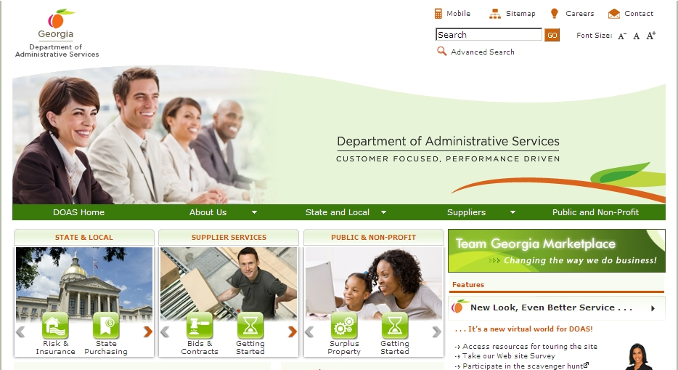
Where to Find this Statewide Contract State Purchasing Division – Statewide Contracts
1. Visit the DOAS website at www.doas.ga.gov.

Slide 21
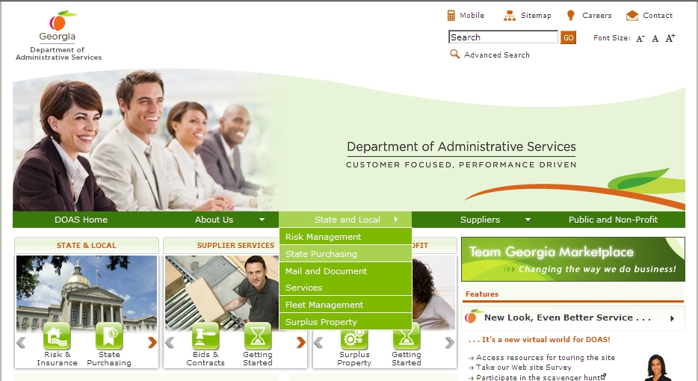
Where to Find this Statewide Contract State Purchasing Division – Statewide Contracts
Hover over the State and Local section of the screen
2. Hover over the State and Local section of the screen.
3. Click on State Purchasing.

Slide 22
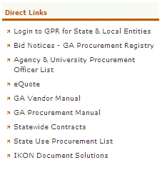
Where to Find this Statewide Contract State Purchasing Division – Statewide Contracts
Click on Statewide Contracts
4. In the Direct Links section, click on Statewide Contracts.

Slide 23
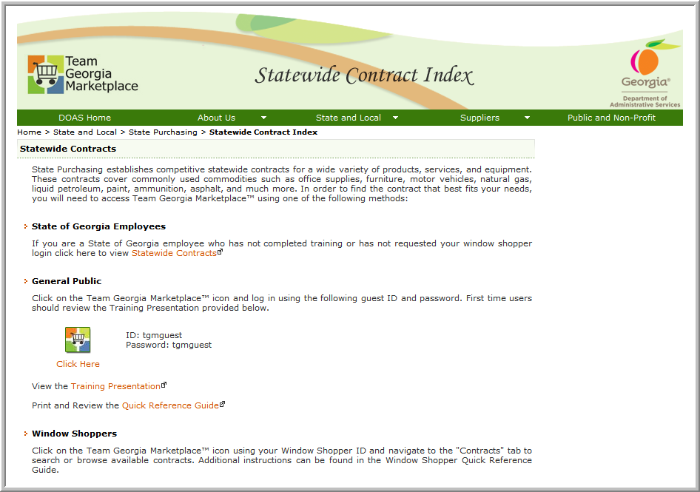
SWC Index for Public
5. To access contract information, click on the Team Georgia Marketplace™ icon to access the Login screen. This User Name and Password is generic and only provides access to contract information.
Use tgmguest
as the User Name and the Password

Slide 24
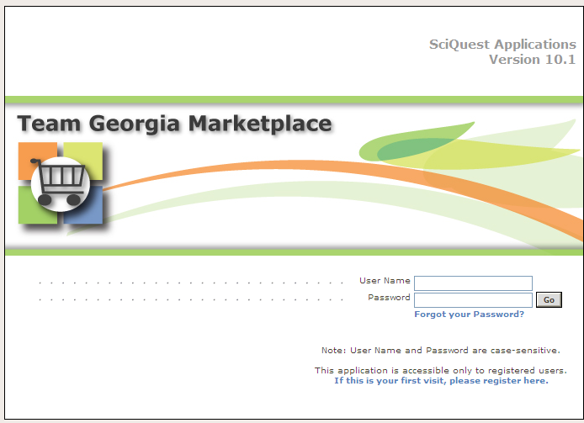
Statewide Contracts Index
6. When the Login screen displays, use tgmguest as the User Name and the Password. This generic ID and Password allows access to contract information only.
Use tgmguest
as the User Name and the Password

Slide 25
SWC Index for Window Shoppers
You can also click on the Team Georgia Marketplace™ icon to access the same Login screen, but enter your personal Window Shopper User Name and Password. This allows you to access the Statewide Contract Index as well as to shop for items available from the Statewide Contracts.

Slide 26
SWC for Window Shoppers
If you are a Window Shopper user, you can access the Statewide Contract Index by entering your personal User Name and the Password once the Login screen displays. Then, click on the Contracts tab.
Use your Window Shopper User Name and Password

Slide 27
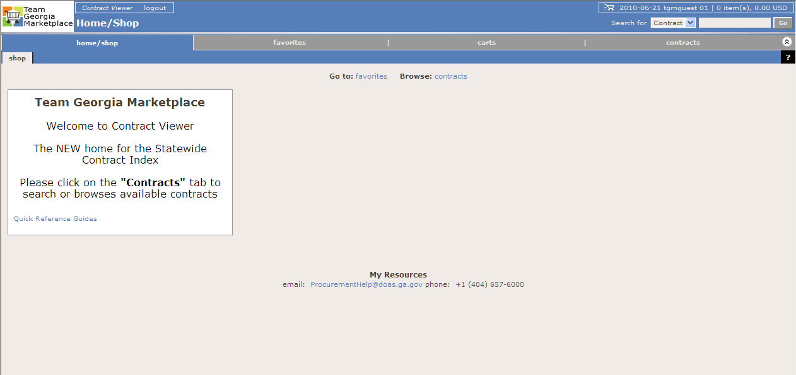
Team Georgia Marketplace Contracts
Once you access the system using the generic or your personal User Name and Password, click on the Contracts tab to access the Statewide Contracts.
Click on the Contracts tab

Slide 28
CUSTOMER FEEDBACK
Survey Monkey
https://www.surveymonkey.com/s/CustomerFeedbackVehicleRental
Comment cards
Located at the Hertz Capitol Hill location only
DOAS website
You may be able to view the link by going to “News” on the Homepage of the DOAS website (you may have to click on “More News” to view the customer feedback link)
Contract Summary page in TGM
If there is a negative comment you must include your contact information
Notes:
Was your vehicle ready when you arrived
Was your vehicle clean and good working condition
Was it in good mechanical condition
Rental Experince

Slide 29
For more information State Purchasing Division – Statewide Contracts
Submit Questions To:
Email Address:
Debra.white@doas.ga.gov
Person to Contact:
Debra White
Phone Number:
404-463-0232
This Webinar
A copy of this webinar will be posted on the State Purchasing Division website.

Slide 30
Supplier Contact Information
The Hertz Corporation
Brian Burtzlaff
Regional Sales Manager bburtzlaff@hertz.com
404-849-2603
Enterprise Car Rental
Heather Pastrick
Director of Business Sales
heather.s.pastrick@ehi.com
404-886-8668
BUSMAX
Corey Rhodes
Regional Vice President
corey@busmaxrental.com
706-291-0600
Notes:
Brian is not new, he has been with us since the beginning of the program

Slide 31
Questions…
?

